Slide 1
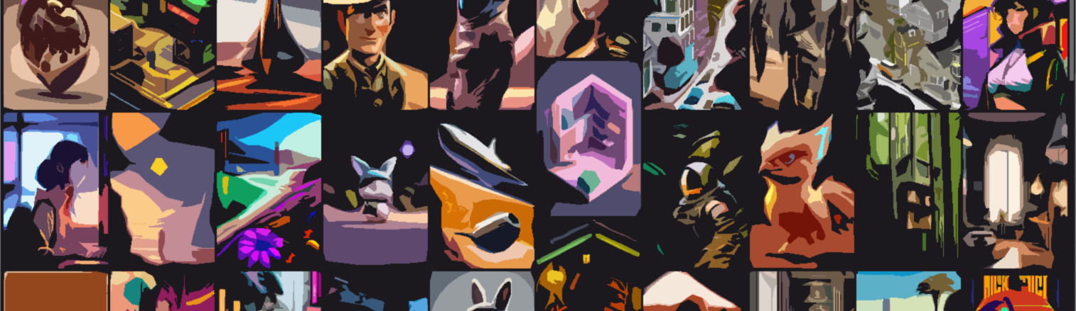
Stable Diffusion
احمد محمود حسيني
علي ماهر عبدالسلام
محمد احمد طه
محمد حسام
محمد عاطف

Slide 2
Content
Introduction
Model
Experiments & Results
Conclusion

Slide 3
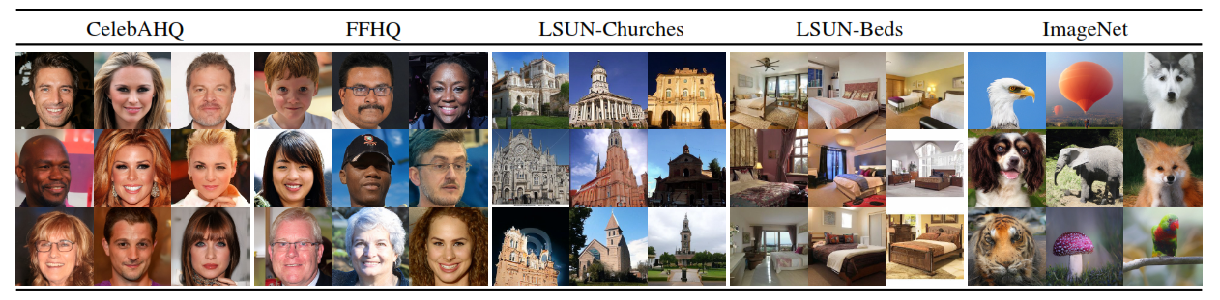
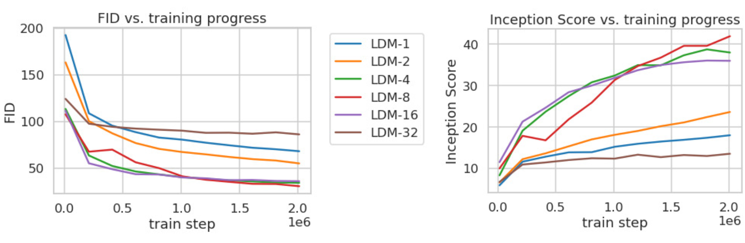
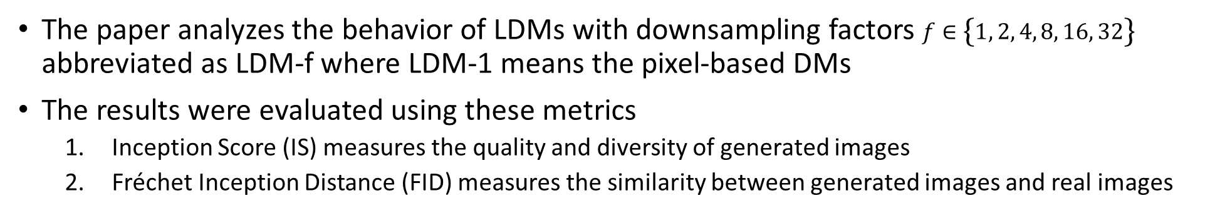
1. Compression Trade-off
Stable Diffusion
Experiments & Results
The LDM-4 and LDM-8 offer the best conditions to achieve high-quality synthesis results
The paper analyzes the behavior of LDMs with downsampling factors $f∈\left\{1, 2, 4, 8, 16, 32\right\}$ abbreviated as LDM-f where LDM-1 means the pixel-based DMs
The results were evaluated using these metrics
Inception Score (IS) measures the quality and diversity of generated images
Fréchet Inception Distance (FID) measures the similarity between generated images and real images

Slide 4
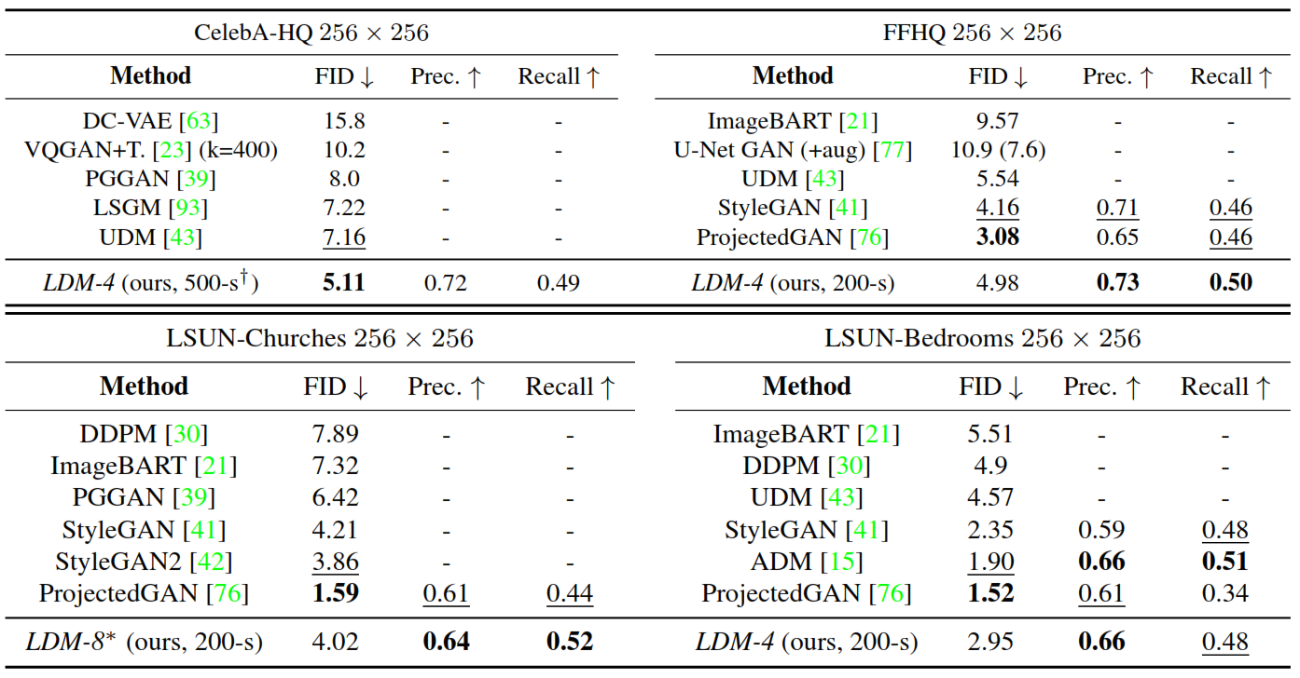
2. Image Generation with Latent Diffusion
Stable Diffusion
Experiments & Results
training of unconditional models of 256x256 images on the mentioned datasets. Then evaluate the quality using FID, Precision and Recall
A new state-of-the-art FID of 5.11
LDMs consistently improve upon GAN-based methods in Precision and Recall

